Slide 1
CHAPTER-2 Sound and Audio
By: Ramesh Pd. Basaula

Slide 2
Contents
2. Sound and Audio
2.1 Basic sound concept representation and formats, basic music (MIDI) concepts devices
2.2 Message
2.3 Standards and software speech: generation analysis and transformation.

Slide 3
Basic Sound Concept
Sound is produced by the vibration of matter.
During the vibration, pressure vibrations are created in the air surrounding it.
The alternation of high and low pressure is propagated through air in a wave like motion.
When a wave reaches a human ear a sound is heard.
The wave form repeats the same shape at regular interval and this portion is called period.
The pattern of the oscillation is called a waveform.
Sound wave is never perfect, smooth or uniformly periodic.

Slide 4
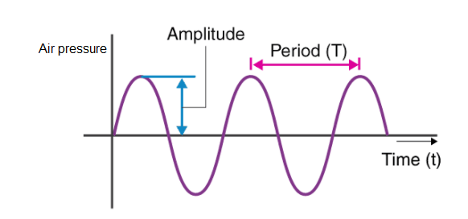
Figure: Sound waveform

Slide 5
Frequency:
The frequency of sound is reciprocal value of the period; it represents the number of periods in a second and measured in hertz (Hz) or cycles per second (cps).
The frequency range is divided into:
Infra – sound – From 0 to 20 Hz
Human hearing frequency range – From 20 Hz to 20 KHz
Ultrasound – From 20 KHz to 1GHz
Hyper sound – From 1GHz to 10 THz
Multimedia systems typically make use of sound only within the frequency range of human hearing.
Amplitude:
A sound also has amplitude, a property subjectively heard as loudness.
The amplitude of a sound is the measure of the displacement of the air pressure wave from its mean or quiescent state.

Slide 6
Characteristics of sound
Pitch:
It is the frequency of sound perceived by human ear.
2. Loudness
It is a sensation of how strong a sound wave is at a place.
Loudness is measured in decibel (dB).
3. Wave length
The minimum distance in which a sound wave repeats itself is called its wavelength.
4. Time period
The time required to produce one complete wave or cycle is called time-period of the wave.
5. Amplitude
6. Frequency

Slide 7
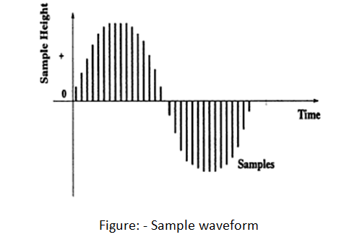
Computer Representation of Sound
The smooth, continuous curve of a sound waveform is not directly represented in a computer.
A computer measures the amplitude of the waveform at regular intervals to produce a series of numbers.
Each of these measurements is a sample.

Slide 8
Sampling:
Sampling is the process of recording an analog signal at regular discrete moments of time.
Each of this measurement is called sample.
This process is called sampling.
It is done in x-axis.
Sampling interval: time interval between samples.
Sampling rate:
The rate at which a continuous wave form is sampled is called sampling rate.
Like frequency, sampling rate is measured in Hz.

Slide 9
Quantization:
It is the process of mapping a large set of input values to smaller set.
The quantization of the sample value depends on the number of bits used in measuring the height of the wave form.
It is done in y-axis.
An 8-bit quantization yields 256 possible values.
The lower quantization lower quality of sound, higher quantization higher quality of sound.

Slide 10
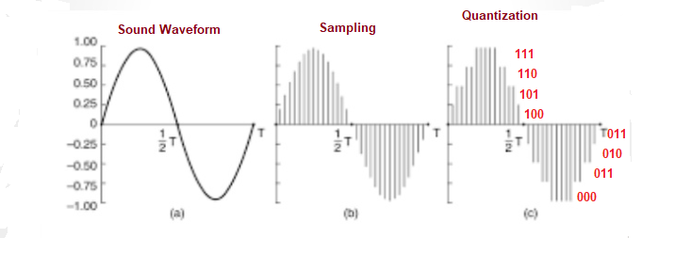
Y-axis
X-axis
Figure: Sampling and Quantization

Slide 11
Sound Hardware:
Before sound can be processed, a computer needs input/output devices.
Microphone jacks and built-in speakers are devices connected to an ADC and DAC, respective for the input and output.
Music
It is a periodic sound.
The relationship between music and computer has become more and more important, especially considering the development of MIDI and its important contribution in the music industry.
MIDI (Musical Instrument and Digital Interface)

Slide 12
MIDI (Musical Instrument and Digital Interface)
It is a protocol developed in the 1980's which allows electronic instruments and other digital musical tools to communicate with each other.
It is a technical standard that describes a communications protocol, digital interface, and electrical connectors that connect a wide variety of electronic musical instruments, computers, and related audio devices for playing, editing and recording music.
It is a protocol designed for recording and playing back music on digital synthesizers that is supported by many personal computer sound cards.
It is not responsible for musical data transmission.

Slide 13
MIDI interface has two different components:
1. Hardware:
Hardware connects the equipment.
It specifies the physical connection between musical instruments.
A MIDI Port is built in to the instrument and it specifies MIDI cable and deals with electronic signals that are sent over the cable.
2. A data format:
Data format encodes the information travelling through the hardware.
MIDI data format is used to transfer audio data.
MIDI data format is digital. The data are grouped into MIDI message.
Each MIDI message can communicate one musical event between instruments.

Slide 14
Components of MIDI System
1. Synthesizer:
It is a sound generator (various pitch, loudness, tone).
A good (musician's) synthesizer often has a microprocessor, keyboard, control panels, memory, etc.
Sequencer:
It can be a stand-alone unit or a software program for a personal computer. (It used to be a storage server for MIDI data. Nowadays it is more a software music editor on the computer.
It has one or more MIDI INs and MIDI OUTs ports
3. Track:
Track in sequencer is used to organize the recordings.
Tracks can be turned on or off on recording or playing back.

Slide 15
4. Channel:
MIDI channels are used to separate information in a MIDI system.
There are 16 MIDI channels in one cable.
Channel numbers are coded into each MIDI message.
5. Timbre:
The quality of the sound, e.g., flute sound, cello sound, etc.
Multi-timbral - capable of playing many different sounds at the same time (e.g., piano, brass, drums, etc.)
6. Pitch:
musical note that the instrument plays
7. Voice:
Voice is the portion of the synthesizer that produces sound.
Synthesizers can have many (12, 20, 24, 36, etc.) voices.
Each voice works independently and simultaneously to produce sounds of different timbre and pitch.
8. Patch:
the control settings that define a particular timbre.

Slide 16
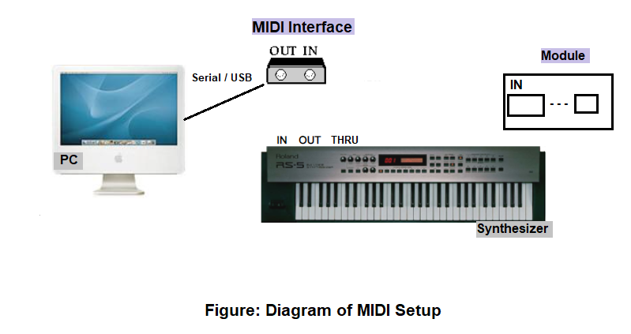

Slide 17
MIDI Devices
Sound Generator:
Sound generator do the actual work of synthesizing.
It is the sound generator.
The principal propose of the generator is to produce a audio signals that becomes sound when fed into loud speaker. By changing the voltage oscillation of the sound signal, a sound generator changes the quality of the sound, i.e. pitch, loudness.
Microprocessor (Controller):
It communicate with keyboard to know what notes a musician is playing and what command the musician want to send. Microprocessor then specifies note to sound generators. In other words microprocessor sends and receives MIDI message.
Keyboard:
Keyboard provides the musician direct control of the synthesizer, pressing the keys on the keyboard. Which instruct the microprocessor what notes to be played and how long to play them?
Control Panel:
It controls those functions that are not directly concerned with notes and duration. The panel controls include a slider that sets the overall volume of synthesizer a button that turns the synthesizer on, off.
Auxiliary Controller:
Auxiliary controller are available to give more control over the note played on the keyboard. It concern with notes and duration. Two common variables on synthesizer are pitch band and modulation.
Memory:
Synthesizer memory is used to store patches for the sound generators and setting of the control panel.

Slide 18
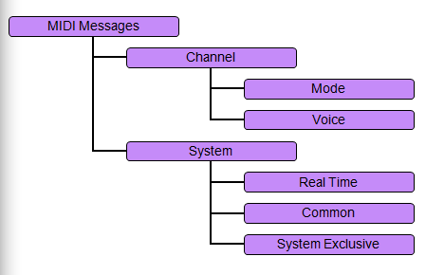
MIDI Message
It transmits information between the MIDI devices and determines what kinds of musical events can be passed from device to device.

Slide 19
1. Channel Message:
It goes only to specified devices.
There are two types of channel message.
a) Channel Voice Message:
Channel Voice message send actual performance data between MIDI devices.
They describe music by defining pitch, note on, note off channel pressure, etc.
b)Channel Mode Message:
Channel Mode message determine the way that a receiving MIDI device respond to channel voice message.
It deals with how to play notes coming in over MIDI cables.
It includes Omni On, Omni Off, note off, note on, etc.

Slide 20
2. System message:
System message go to all devices in a MIDI system because no channel number are specified.
There are three types of system message.
a) System Real-time Message:
These are very short and simple, consisting of only one byte.
They carry extra data with them.
These messages synchronize the timing MIDI devices in performance.
To avoid delay these message are sent in the middle of other message if necessary.
b) System Common Message:
System common message are commands that prepares sequencers and synthesizer to play song.
E.g. Song selected, find the common starting place in the song.
c) System Exclusive message:
System exclusive message allow MIDI manufacturers to create customized MIDI message to send between the MIDI devices.

Slide 21
2.3 Standards and software speech: generation analysis and transformation.
It is the vocalized form of human communications.
Speech can be perceived understood, and generated by human and also by machines.
Speech signals have two properties which can be used in speech processing:
Voice speech signals
Format

Slide 22
Speech generation
It is the process of producing speech naturally.
It is the process which allows the transformation of a string of phonetic and prosodic symbols into a synthetic speech signal.
Prosody is concerned with those elements of speech that are not individual phonetic segments (vowels and consonants) but are properties of syllables and larger units of speech, including linguistic functions such as tone, rhythm, etc.
Generated speech must be understandable and sound natural.
Artificial production of sound/speech is known as speech synthesis, which is done by using computer system.

Slide 23
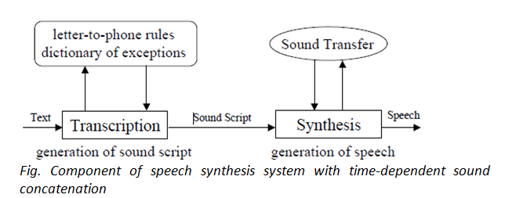
Speech Synthesis
Speech synthesis is the artificial production of human speech.
Step 1: Generation of a Sound Script
Transcription from text to a sound script using a library containing (language specific) letter-to phone rules.
Step 2: Generation of Speech
The sound script is used to drive the time- or frequency-dependent sound concatenation process.

Slide 24
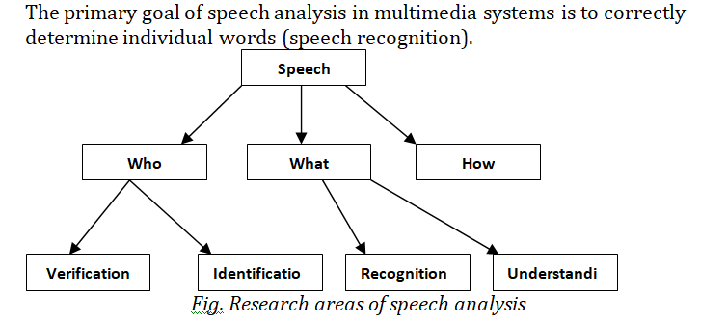
Speech Analysis
ng

Slide 25
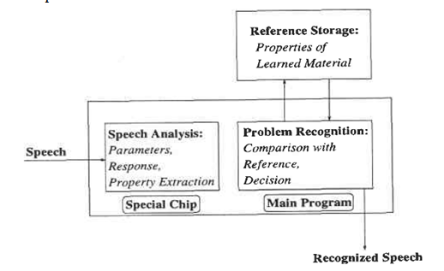
Speech Recognition
Figure: - Speech recognition system

Slide 26
Speech Transmission
The area of speech transmission deals with efficient coding of the speech signal allow speech / sound transmission at low transmission rates over networks.
The goal is to provide the receiver with the same speech/sound quality as was generated at the sender side.
Some Techniques for Speech Transmission:
(1) Pulse Code Modulation:
It is a common method of converting analog signals into digital signals.
It meets the right quality demand stereo audio signals in the data rate used for CD. Its rate is 176400 bytes/s.

Slide 27
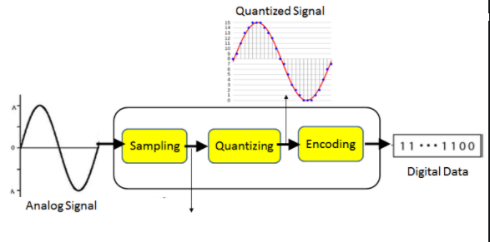
Figure: PCM
It has following steps:
a)Sampling b) Quantization c)Encoding
Encoding:
The digitization of analog signal is done by the encoder.
It designates each quantized level by a binary code.

Slide 28
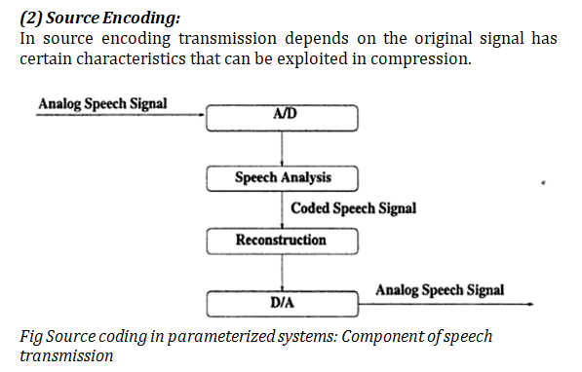

Slide 29
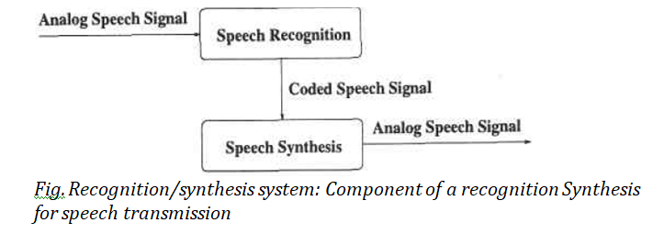
(3) Recognition-Synthesis Method:
This method conducts a speech analysis and speech synthesis during reconstruction speech elements are characterized by bits and transmitted over multimedia system.
The data rate defines the quality.

